Slide 1
Family Project
Early Intervention

Slide 2
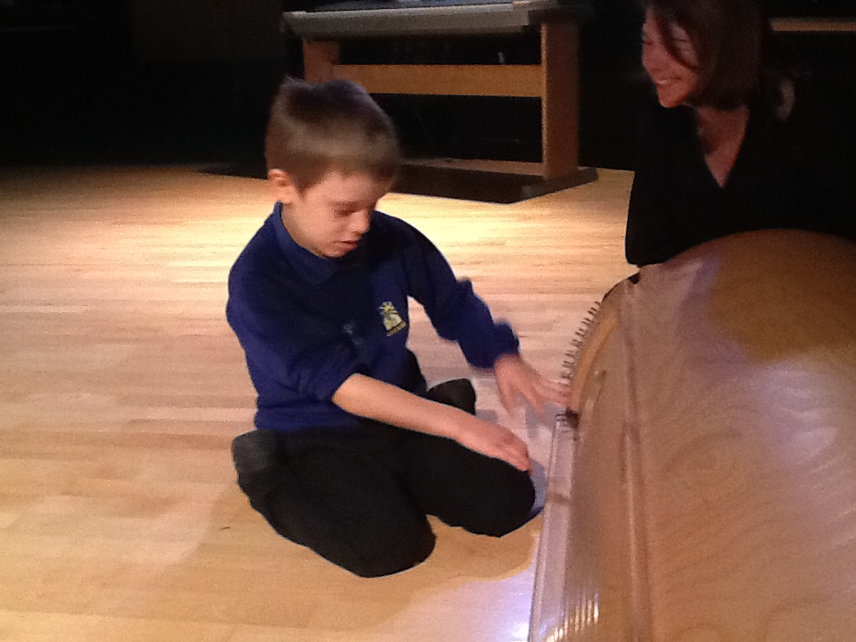

Slide 3
Research project.
Why? Our story.
Needing a 21st century approach for these complex children. Square pegs into round holes
Early intervention- what can that really look like?

Slide 4
Wired differently.
Many children now with multiple diagnosis and extremely complex presentations.
Survival of very premature babies..rates increasing… parts of the brain not had opportunity to develop….wired differently. 96% of babies born 28-31 weeks gestation survive.
Increasing concern over how schools can meet the needs of these children…are we ready for this? Do we need a different type of thinking on this, a different approach? We need a better understanding of how we can best meet the needs of different sub groups of children with complex needs.

Slide 5
Study tour…
Champion centre NZ
…leading work in early intervention…especially for premature babies. What could we learn from the Champion centre? What is working successfully there with the most complex of children? SEN children in NZ don’t have to start school until age 7.

Slide 6
Champion Centre

Slide 7
Relationship based intervention..
The Champion Centre provides relationship-based early intervention services to infants and young children with complex disabilities. Parents and children visit the Centre each week and have one-on-one individualised sessions with each of the members of a multi-disciplinary team. All teams involve either a physiotherapist or an occupational therapist, a speech and language therapist, and an early intervention teacher. Most teams also have music specialists, computer supported learning specialists and playroom specialists. All families also have access to the family support team; and most children over three years old are supported by an Education Support Worker when they attend their community early childhood centre.
The Champion Centre programme is based on the philosophy that all learning occurs in the context of healthy relationships between the infant or child and those who live with and love them. We operate from the perspective that every child, no matter what developmental challenges they face, will learn and grow through the intervention of skilled therapists and informed parents/caregivers. All staff are trained in human development and use this knowledge to both teach the underlying components of functional skills and help children integrate these into daily living and learning through play-based activities that utilise children's interests and strengths.

Slide 8
The challenge…
How to use the model in a school setting…
Barriers…cost, time, finding the right professionals to form a team, space, family engagement, other school priorities and looming OFSTED!

Slide 9
Mulled it over….
8 months mulling, reflecting and starting to sound out others thoughts…and finding some like minded therapists and professionals able to work with us.
Gathering the team…what I wanted..
OT, Speech and Lang therapist, Early Years teacher, Musical Play, Theraplay.

Slide 10
Gathering Key team members…
Head of Early Years
OT
SLT
Theraplay
Musical play
Selecting pupils and families to be involved.
Logistics…

Slide 11
What happened before the project started?
Parents contacted directly to discuss our plans, what we hoped to achieve and why we wanted to do it. We chose specific pupils that we had identified with class teachers as having a more significant need.
We needed to ascertain how many families wanted to be involved and those who would be able to commit the time to do so.
All professionals met to discuss room allocations, timetabling issues and to agree on objectives for the 9 weeks.
Baseline assessment tools were shared between the team of professionals.

Slide 12
What happened during the project?
Parents met as a group before the first session ran with professionals to discuss the running of the morning.
The professionals were given a timetable based on prior discussions and parents were given visual schedules for their children. This included any breaks that they had.
The pupils had 5 sessions: Occupational Therapy, Theraplay, Speech and Language, Musical Play and Attention Autism, plus one break (not in this order). Each session lasted for 20minutes.
Parents collected their children from their classes and rotated around the sessions for the full morning. They then returned their child to class at lunch time.
Parents met for a de-brief meeting in the staff room.
All professionals then met after lunch time to share significant progress and areas for development in the next session, in addition to other timetable changes that needed to happen.

Slide 14
Attention Autism
Attention Autism a programme developed by Speech and Language Therapist Gina Davies. More information can be found at www.ginadavies.co.uk
Gina is a qualified Speech and Language Therapist who turned her passion for communication development into practical and joyful intervention strategies for parents and professionals dealing with autism.
Attention Autism builds on the child’s engagement through 4 phases which get built up over time: brief engagement with sensory toys, attention builder, turn taker (including with other pupils), individual learning task.

Slide 15
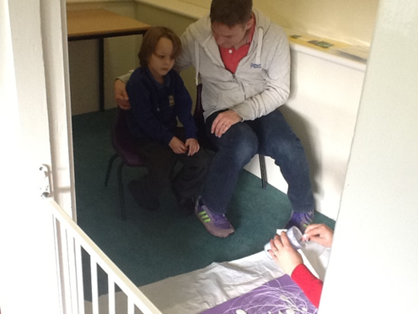
Attention Autism

Slide 16
Occupational Therapist.
Sensory Processing and Integration
Sensory Assessments
Harcourt Sensory Profile (3-10)
Formalised Assessment
Gives good information on too much too little sensation received, (hearing, touch, balance, body awareness vision)
Observation
Helps understand child’s arousal responses
Social and classroom performance

Slide 17
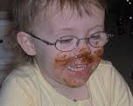
Reports
Used to Communicate
1) Senses that trigger fear or overload
2) Senses that are needed to help focus
3) Senses that help calm
4)Good reward Strategies!

Slide 18
10 weekly 20 minute sessions
It felt like a step into the unknown!

Slide 19
A unique chance to see parents with their child
Time to tailor to child and parent needs
A platform to build skills and sharing
A safe space to advise, listen and try new ideas
The benefit input of the other therapists
An opportunity get it wrong and delight parents! They love this!!

Slide 20
Speech and Language
Aims for the child
Attention
Use Core Vocabulary to request, direct and comment;
Intensive Interaction, focussing on eye-contact/turn-taking/sharing attention.
Transition from one session to the next

Slide 21
Aims for the parent
For the parent to learn how to create opportunities to encourage interaction;
For parents to understand and use the principles of the Intensive Interaction approach;
For parents to understand the benefits of a Total Communication approach (use of real objects/photos/signs and symbols) and use these in functional communicative situations;
For parents to understand and use pausing appropriately to encourage spontaneous language to request, direct and comment;
For parents to have an awareness of core vocabulary and use these within everyday situations;

Slide 22
Therapy aims
To assess the child’s communication needs/abilities and ensure the interaction strategies used within the session optimised their communication potential;
Liaise with other professionals, ensuring recommended strategies are used across the different sessions to enable the child and parent to generalise their skills within a safe and structured environment;

Slide 23
Intensive Interaction
Intensive interaction is an approach to teaching the pre-speech fundamentals of communication to children and adults who have severe learning difficulties and/or autism and who are still at an early stage of communication development.
Learning to give brief attention to another person.
To share attention with another person.
Learning to extend those attentions, learning to concentrate on another person.
Developing shared attention into 'activities'.
Taking turns in exchanges of behaviour.
To have fun, to play.
Using and understanding eye contacts.
Using and understanding of facial expressions.
Using and understanding of non-verbal communication such as gesture and body language.
Learning use and understanding of physical contacts.
Learning use and understanding of vocalisations, having your vocalisations become more varied and extensive, then gradually more precise and meaningful.

Slide 24
Core words
Words that can be used in lots of different situations and for lots of different reasons.
80% of what we say is made up of how many core words?
How many words account for 96% of what toddlers say? ….24

Slide 25
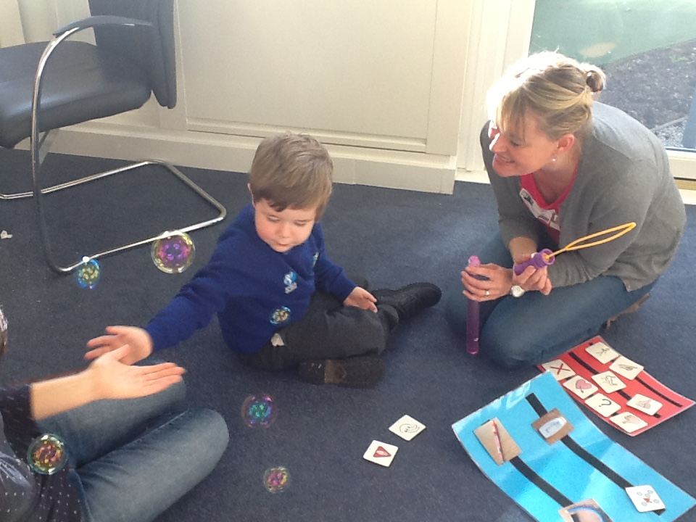

Slide 26
Total Communication
Is the ability to communicate by whatever means available to support understanding and expression
Speech
Vocalisations
Signs
Symbols
Photos
Real objects

Slide 27
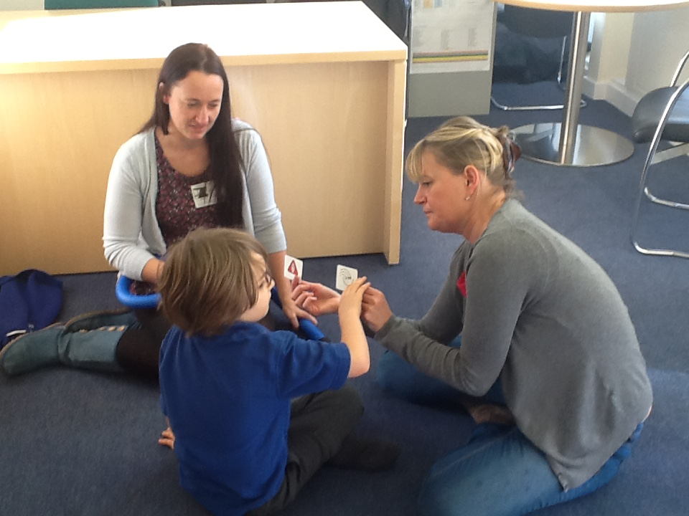

Slide 28
Pausing
Stop
Stop your own ideas or agenda
Wait to see what happens
What is your child interested in?
How is he communicating
What sounds/words/phrases is he making?
WATCH
& LISTEN
Copy
Comment on what the child is doing
RESPOND

Slide 29
Creating opportunities
Add a choice;
Do something new – make it funny to encourage interaction;
Miss something out;
Make a mistake;

Slide 30
Outcomes
Parents:
Creating opportunities for communication
Building positive interactive relationships
Use of Total Communication approach at home
Child:
Able to make choices, direct others and commend on things
Parent and child:
Have fun whilst practising important communication skills
Therapist:
working with families encouraged a holistic therapy input
working as part of a MDT improved my own skills and helped me reflect on my own practise

Slide 31
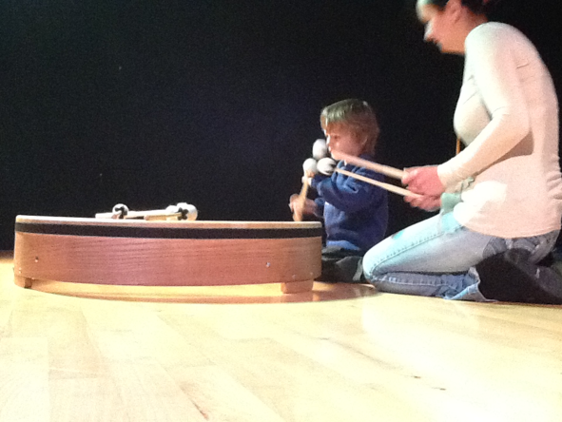
Musical Play
Creating a musically nurturing environment with no music teacher or musicians…bit of a challenge!
I wanted to offer a music programme to provide opportunities for playfulness, warmth, humour and love and give the child experience of success, helping to build self esteem.
Fundamental belief that…each child has an inherent musicality regardless of disability.
Music is a powerful nonverbal form of communication which helps children to feel included and safe.
It is also a vehicle by which other skills, such as dressing, brushing teeth, etc. can be learned.
Can increase opportunities for improved self regulation, engagement with others, shared attention.

Slide 32
SWALSS research grant…
Funding released staff to work on the musical play project weekly…
Train up 2 keen TA’s to ‘have a go’ and work with me on musical play…needed a ‘can do’ attitude….willing to be out of comfort zone.
Training in house together and from Music Zone teacher working alongside us.
Musical play project with 2 pupils initially weekly with family member joining the sessions.

Slide 33
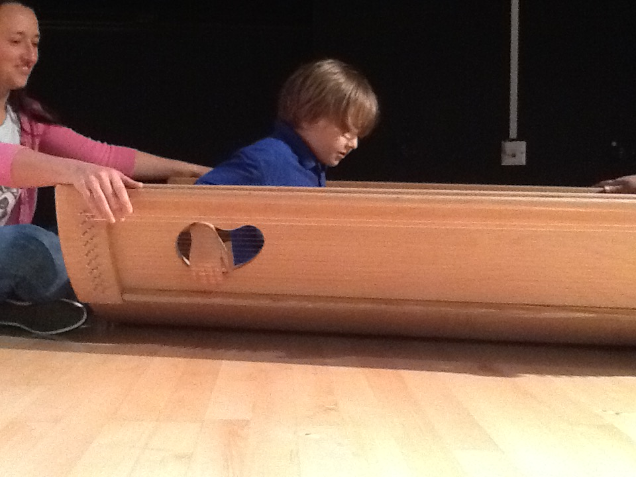
Equipment

Slide 34
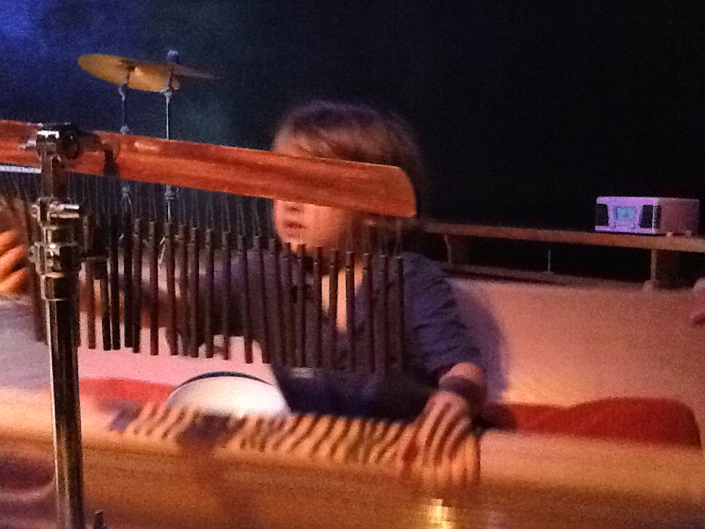
Musical play project so successful we decided to include it in our family project in September.

Slide 35
Feedback
“Wow I can play with my child!”
“Now we understand so much better”
“Toys that actually work (and are cheap)!!!”
“We’ve really seen his core tone develop”
“It’s so much easier now we know he needs to do this”
“Now they really look at me”
“Now we understand about noise levels we’ve started to be able to go out of the house more”

Slide 36
100% of Parents have used the skills they have learnt with the family project at home.
80% of families that took part would like to participate in the project for future cycles. Those families that did not want to participate in the future stated that this was due to work commitments.
100% of families that participated in the project stated that it had been effective at raising the levels of progress for their child.

Slide 37
“A goal is a dream with a deadline.”
- Napoleon Hill

Slide 38
Thank you!

